Slide 1




AI-Based Ballpark Quotation Tool
Checkpoint 3: Results & Agents
Team:
Nida Ejaz
Temur Kuchkorov
Javokhirbek Parpikhodjaev

Slide 2
Table of Contents
Project Objective
Value Proposition
Research Questions
Method
Experiments
Live Demo
Conclusion
Checkpoint 3

Slide 3
Project Objective
Develop an AI-based tool for fast ballpark R&D estimations
Automatically extract key information from PR Excel files
Use historical PR–Offer pairs as training data
Predict function-level R&D effort breakdown
Allow Customer Managers and Function Owners to refine results

Slide 4
Value Proposition
For the Customer Manager:
Speed: Instant preliminary estimations replace days of manual analysis.
Accuracy: Data-driven predictions improve consistency across all quotations.
Efficiency: Drastic reduction in manual workload, allowing focus on high-value tasks
For the Business:
Agility: Faster "Go/No-Go" decisions accelerate the sales cycle.
Standardization: A unified process across all functions and departments

Slide 5


Sustainable Development Goal
SDG 9: Industry, Innovation and Infrastructure
Enhancing industrial capability through digitalization and AI-driven automation.
SDG 12: Responsible Consumption and Production
Reducing "Engineering Waste" by minimizing duplicated efforts and optimizing resource planning

Slide 6
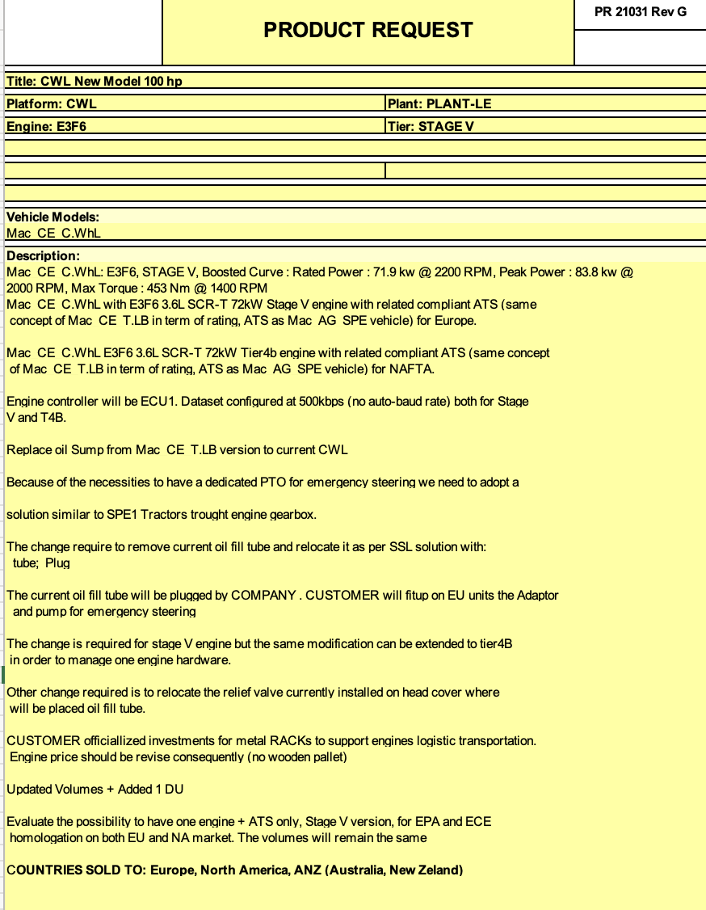
Product Request Input: Excel File

Slide 7
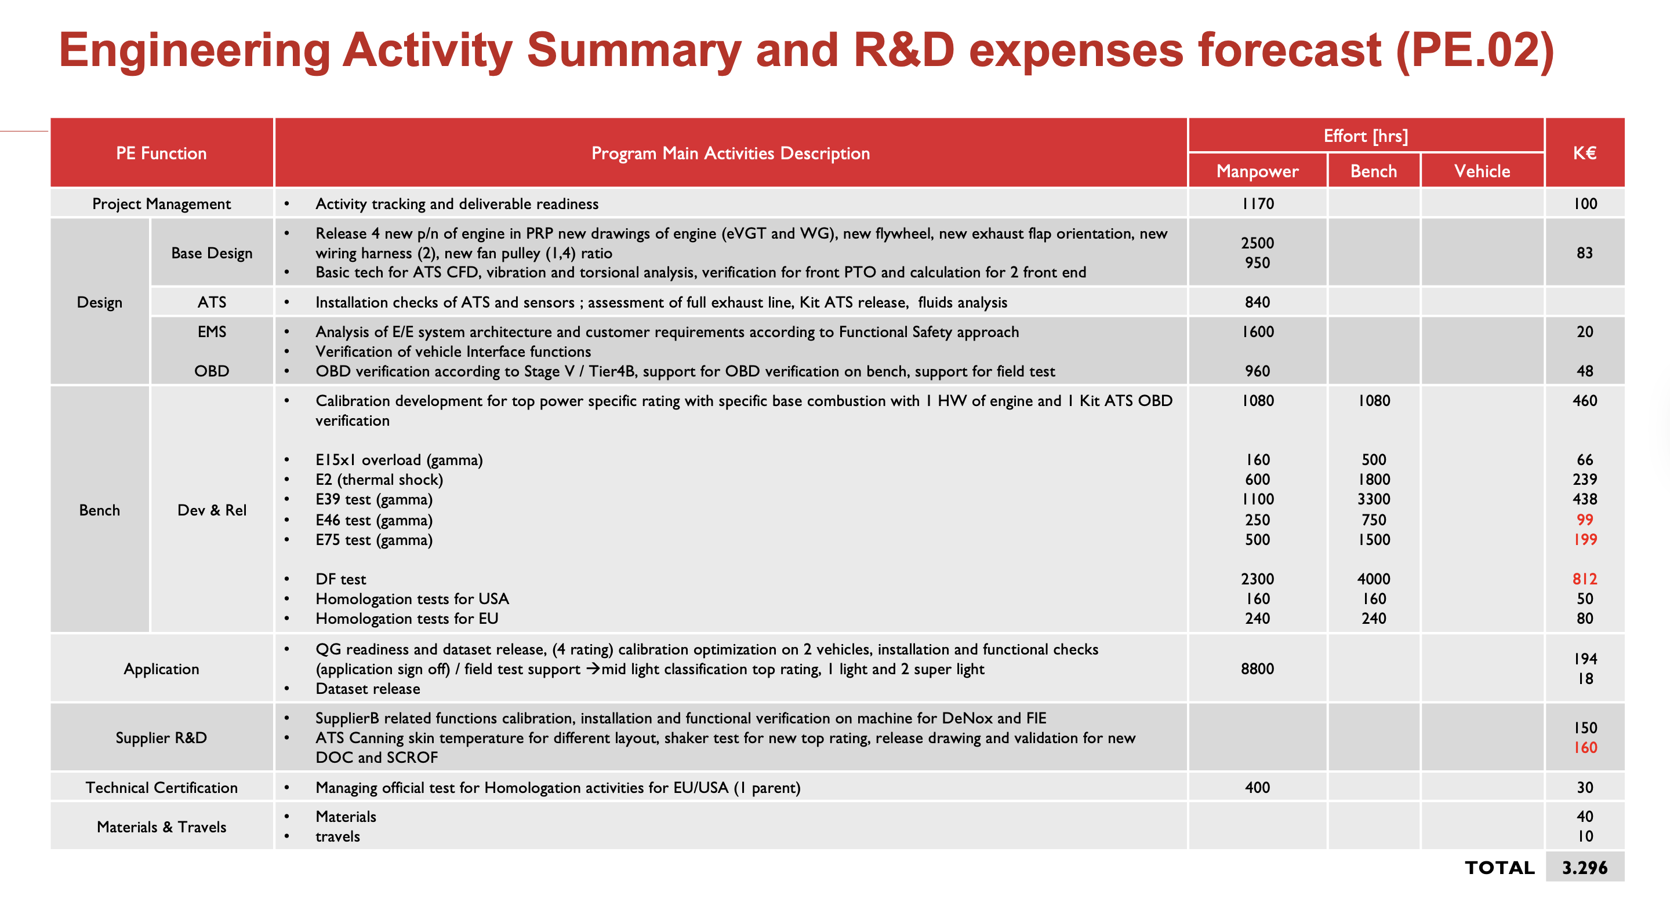
Proposed Quote Function Level R&D

Slide 8
Research Questions
RQ1 - The "Small Data" Challenge: How can we build a reliable prediction model with only 37 historical samples?
RQ2 - Architecture Selection: Is a standalone regression model sufficient for business decision-making?
RQ3 - Scalability & Future Proofing: Will this architecture hold up when IVECO digitizes more data?
RQ4 - Explainability: How can we make AI decisions transparent for engineers?

Slide 9
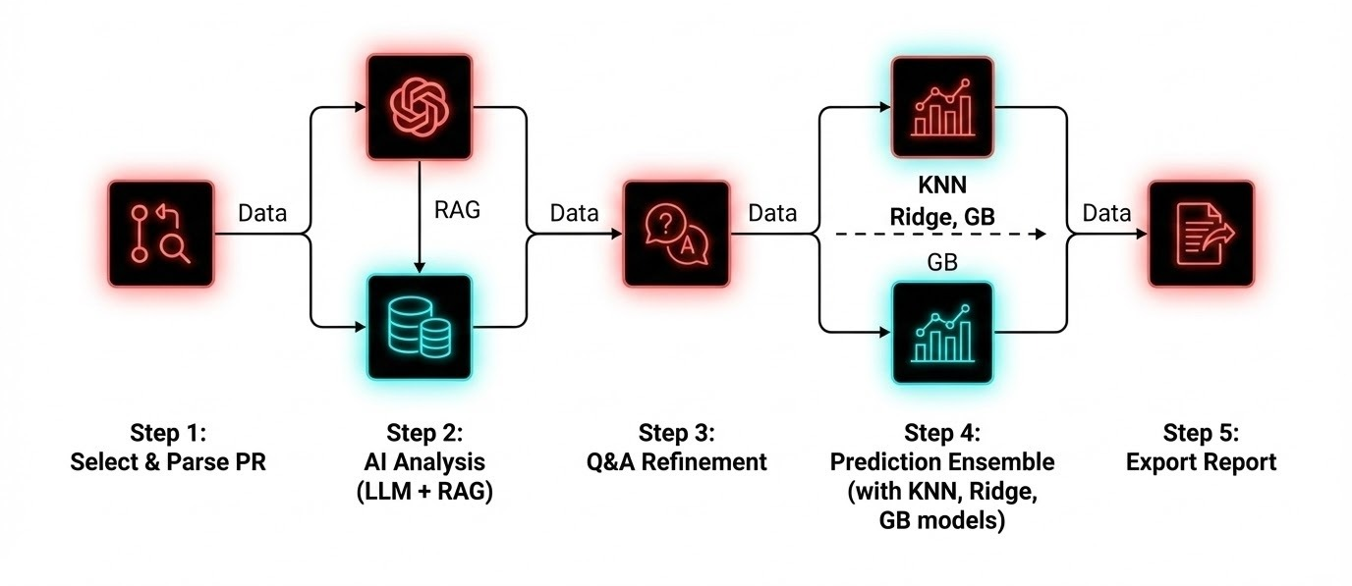
LLM Based Pipeline and Interface for Tool

Slide 10
RQ1
Methodology
Data Pipeline & Feature Engineering
Dataset Foundation
Our methodology began with a meticulously curated dataset of 37 historical Project Records (PRs), ensuring a clean and reliable base for model training.
Transformative Feature Engineering
A critical step involved advanced feature engineering, including Log-Transformation to address significant variance (e.g., €7k vs. €10M projects).
Enhanced Project Complexity
We generated 12 new features, such as 'Calibration Ratio', to more accurately capture and represent project complexity within the model.

Slide 11
RQ1
Retrieval Engine
Grounding Predictions via Qdrant
Mechanism: Semantic Search using Vector Embeddings
Database: Qdrant stores historical project vectors
Action: For each cost cluster, finds Top-3 "Nearest Neighbors"
Grounding: Prevents hallucinations by anchoring predictions in real historical data
Value: Provides analogical reasoning - "This project is similar to these 3 past projects"
Confidence: Historical context increases stakeholder trust in estimates
Retrieval acts as data amplification in low-sample settings

Slide 12
RQ2
The Ensemble Engine Hybrid ML + RAG Prediction Architecture
ML Model: Hierarchical Conformal Quantile Ensemble
Learns patterns from feature engineering
Captures non-linear relationships
RAG Model: Historical Average from Top-3 Neighbors
Learns from specific analogies
Grounds predictions in reality
Hybrid Formula: Final Cost = α(ML) + β(RAG)
Optimal weighting balances statistical rigor with historical grounding
Performance: R² = 0.88
Explains 88% of variance in real project costs
Best performance achieved on actual historical data

Slide 13



RQ2
RAG System
Contextualised Cost Justification
Beyond Numerical Guesses
Retrieval from Qdrant
Our AI tool doesn't just provide cost figures; it offers depth and justification, moving beyond mere numerical predictions.
The Retrieval Augmented Generation (RAG) system actively searches and retrieves the top-3 most similar 'Reference Projects' from our Qdrant vector store.
Providing Context & Confidence
These retrieved projects provide invaluable historical context, enabling the AI to justify the estimated cost and enhance stakeholder confidence.

Slide 14
RQ3,4
The Analyst Agent
DeepSeek V3 Reasoning Layer
Role: Synthesis & Reasoning (not just numerical output)
Input: ML predictions + RAG context + historical patterns
Processing: DeepSeek V3 analyzes and synthesizes all signals
Output: Business-ready report explaining "Why" the cost is high
Intelligence Features:
Flags risks and anomalies (e.g., "Calibration hours 2x historical average")
Provides confidence intervals and uncertainty bounds
Generates executive summary with key drivers
Recommends mitigation strategies for high-risk areas
Value: Transforms raw predictions into actionable business intelligence

Slide 15
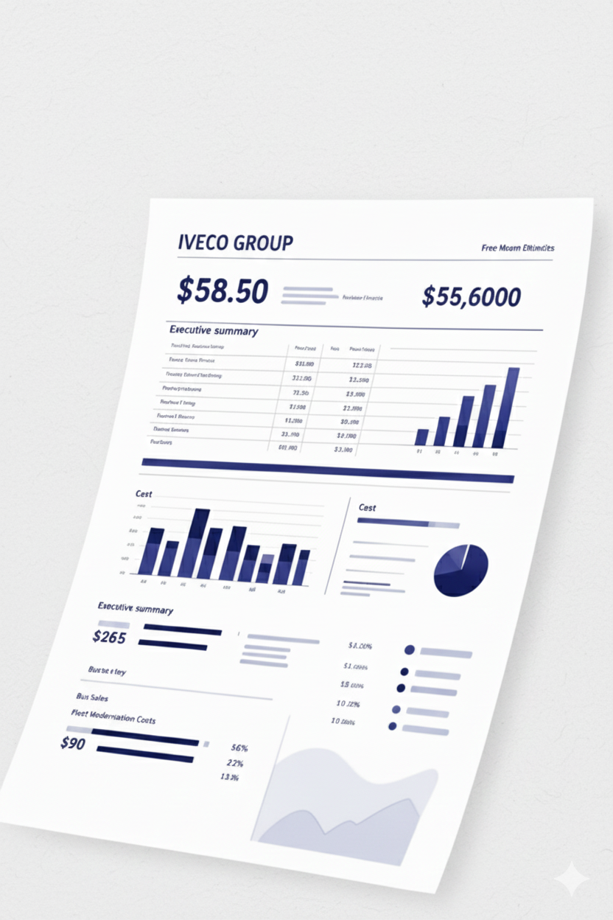
RQ4
Comprehensive
Output: The Excel Report
The final output of our AI-Based Ballpark Quotation Tool is a detailed, user-friendly Excel report, designed to provide comprehensive insights briefly.
Executive Summary
Detailed Cost Breakdown
Confidence Intervals
Clearly defined confidence levels for the estimation, providing a realistic range and aiding in strategic decision-making.

Slide 16
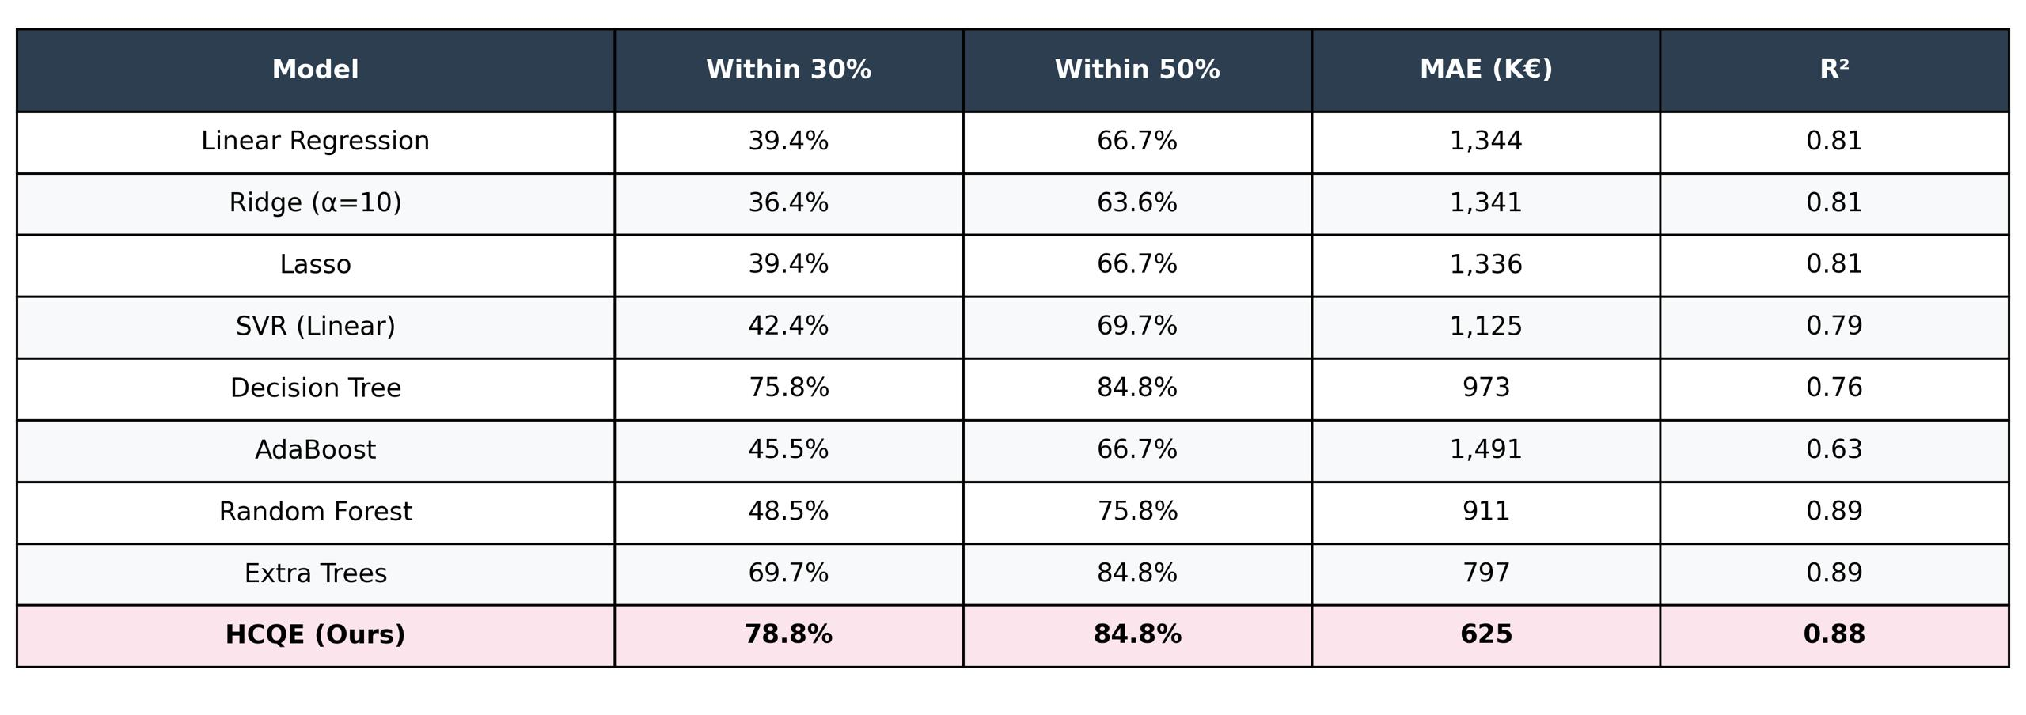

Model Benchmarks
Baseline: Linear Regression ($R^{2}$= 0.81) — Good baseline, stable performance.
Iteration 2: Random Forest ($R^{2}$ = 0.89) — Tried boosting, but performance dropped slightly.
Final (HCQE): Ensemble + Decomposition ($R^{2}$ = 0.88) — High accuracy achieved (Ours).

Slide 17
Live Demo

Slide 18
Manage – Gantt (updated)
 |  | NOV |  |  |  | DEC |  |  |  | JAN
 |  | W1 | W2 | W3 | W4 | W1 | W2 | W3 | W4 | W1 | W2 | W3
Project Management
Project Definition
Design Plan
Management Plan
Data Preparation
Data Collection
Data Cleaning
Model Development
Model Selection and Training
Model Evaluation
Communication
Meetings with Iveco
Checkpoint preparation
Final Presentation
Documentation & Communication
: Completed
CP1
(19/11/2025)
CP2
(10/12/2025)
CP3
(07/01/2026)

Slide 19


THANK YOU

